Slide 1
A Satellite-based Analysis of Tropical Cyclone Rainfall for Improved Flood Hazard Assessment
Catherine Nabukulu
UNIVERSITY OF TWENTE - ITC

Slide 2
Outline
Introduction
Experiments and Results
Conclusions and Recommendations

Slide 3
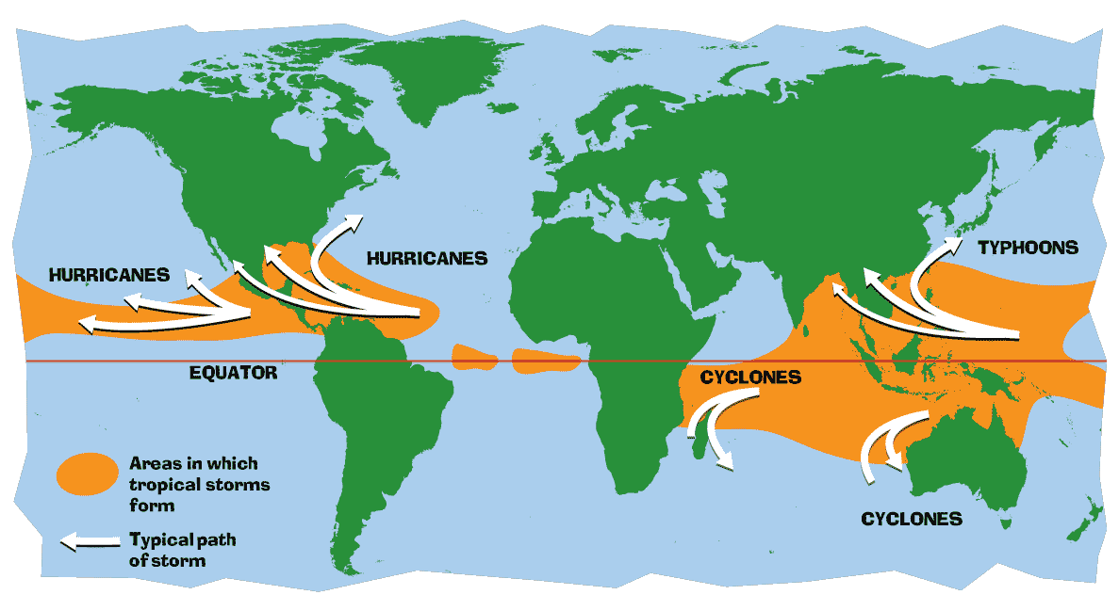
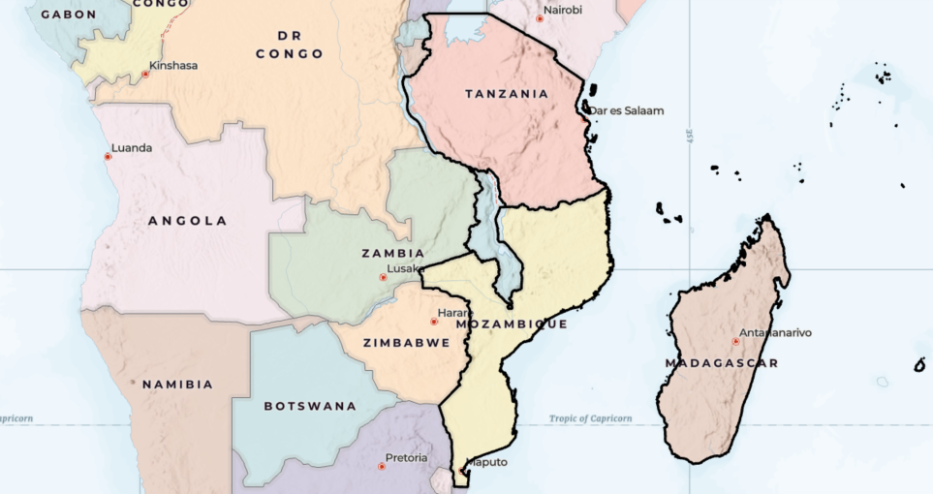
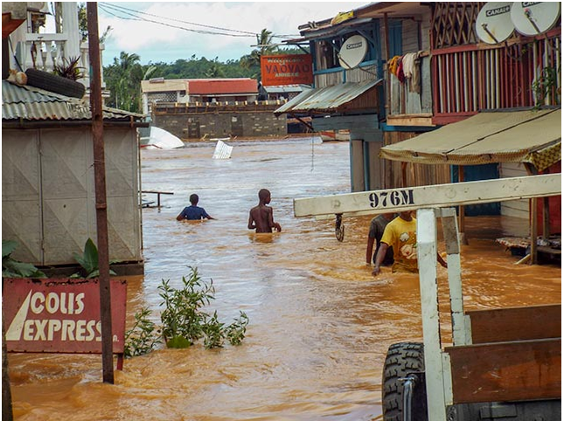
Introduction
Hurricanes
Hurricanes
Typhoons
Cyclones
Cyclones
Are associated with:
  Strong winds
  Torrential rainfall
  Widespread effects
Source: https://gpm.nasa.gov/education/articles www.humanitariancoalition.ca

Slide 4
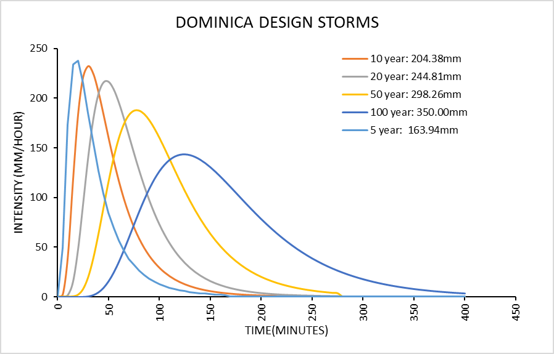
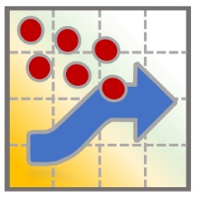
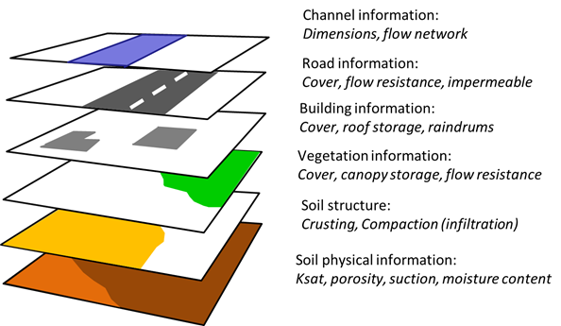
Flood Hazard Assessment
Input Data
Flood Risk Map
DESIGN STORMS
openLISEM Model

Slide 5
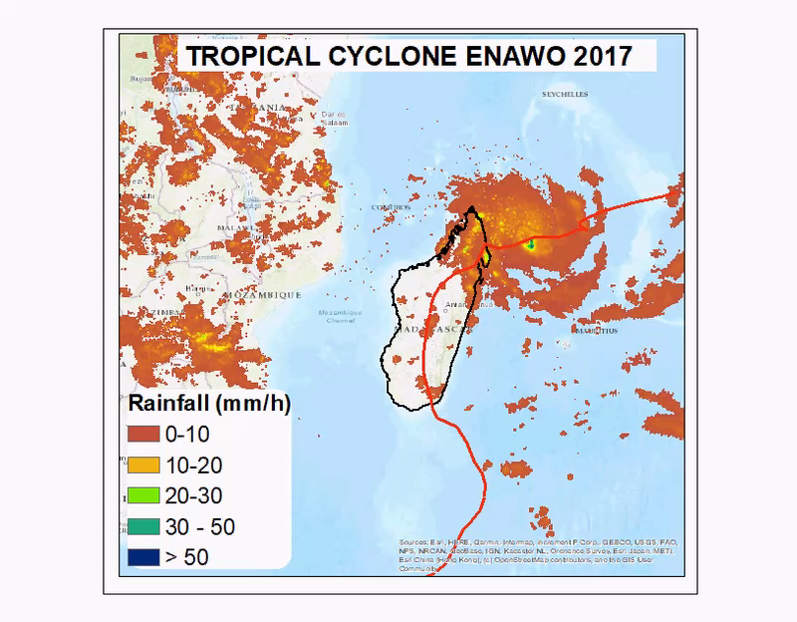
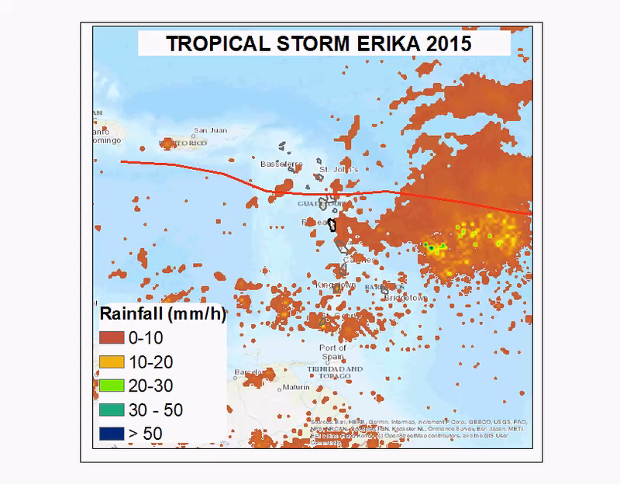
What is happening?
12:00:00 06/03/2017 – 06:30:00 10/03/2017
18:30:00 26/08/2015 – 06:00:00 26/08/2015

Slide 6
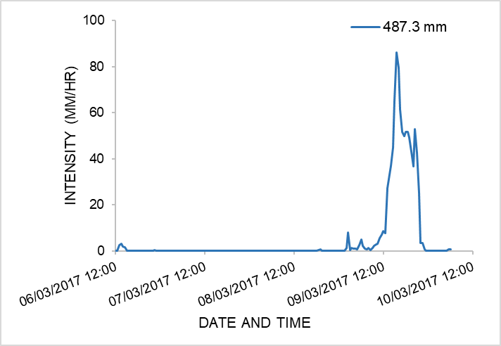
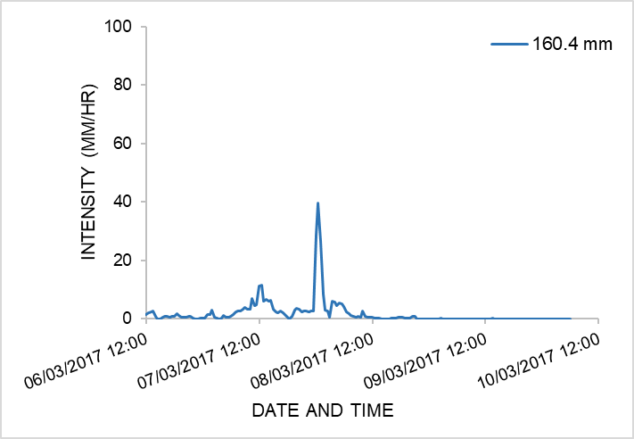
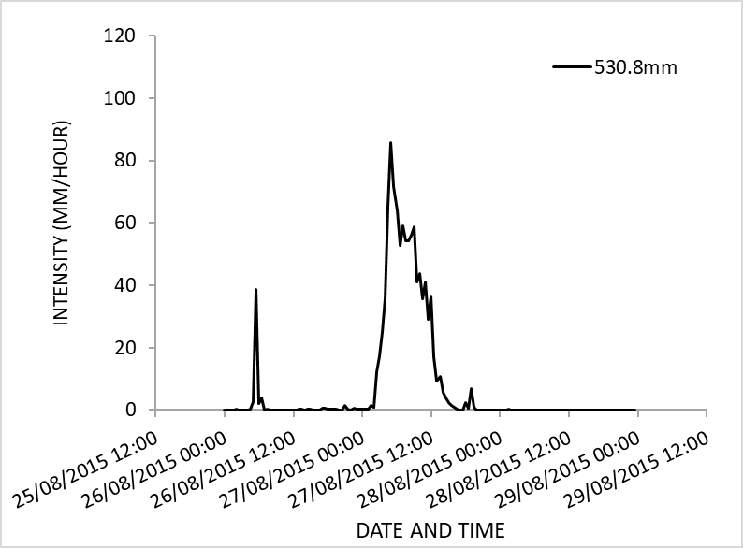
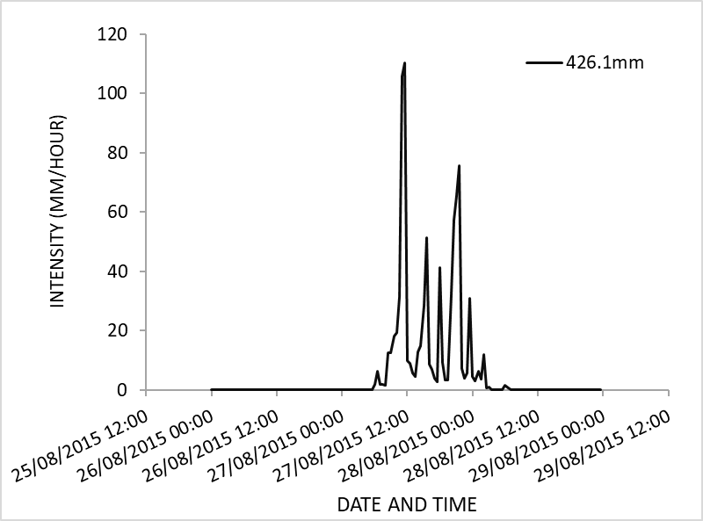
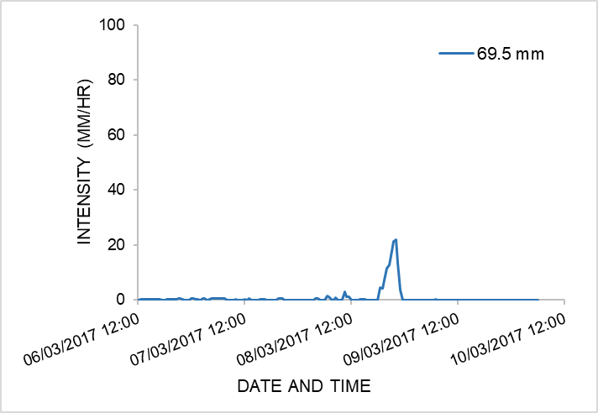
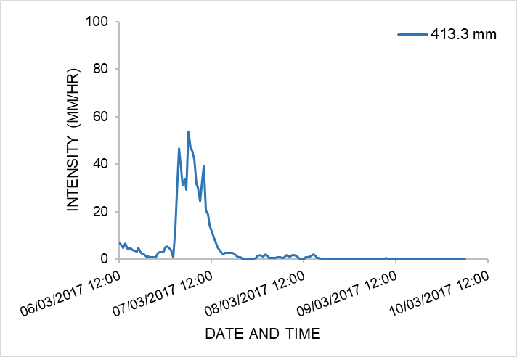
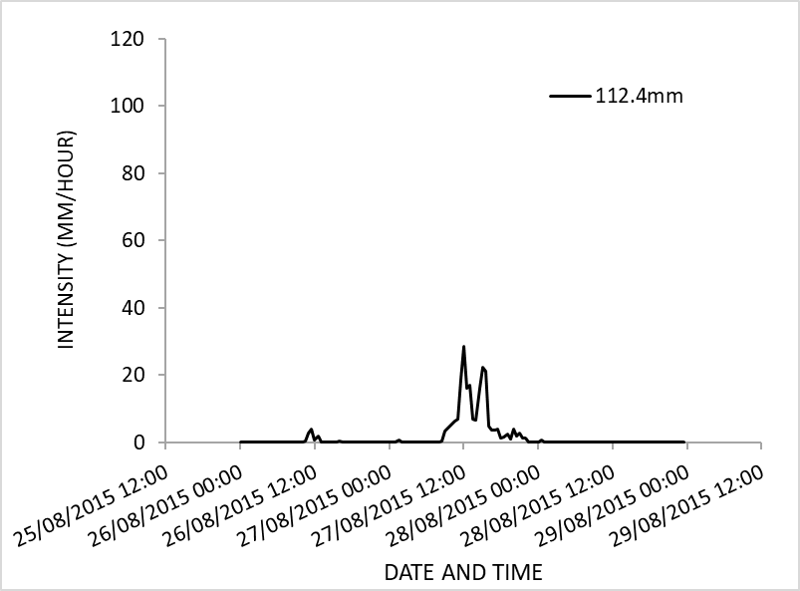
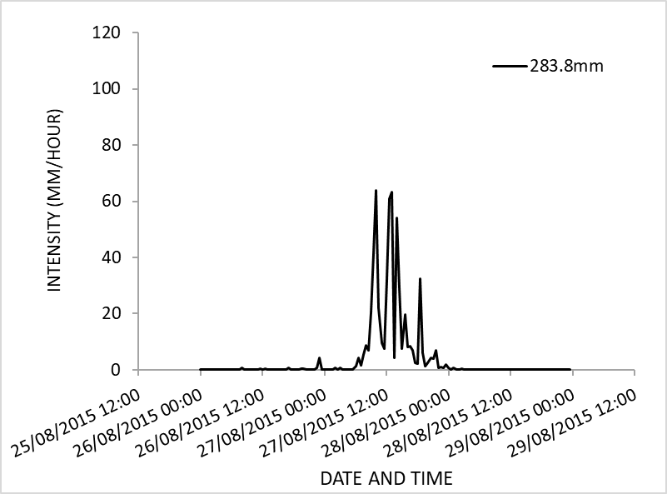
What is happening?
Tropical Cyclone Enawo 2017
Tropical Storm Erika 2015
How can we adequately characterize tropical cyclone rainfall both spatially and temporally for improved flood hazard assessment?

Slide 7
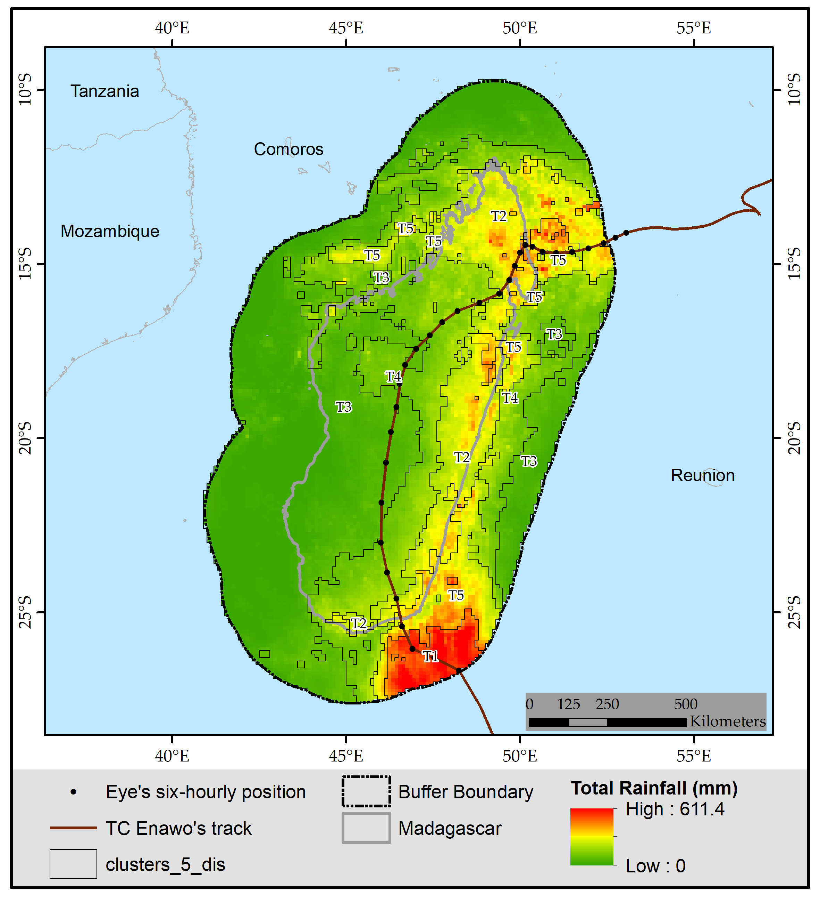
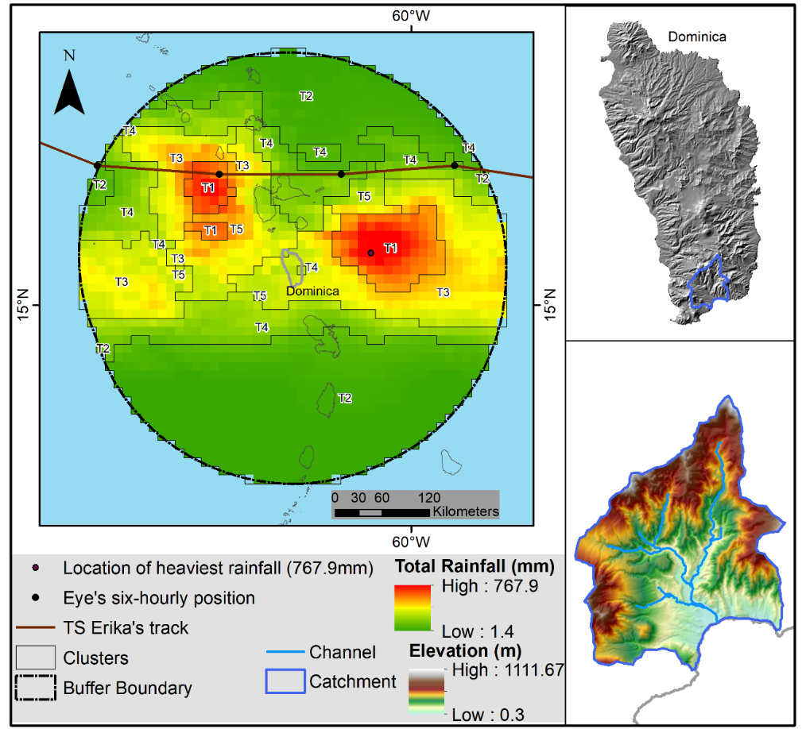
Temporal Clustering
Tropical Cyclone Enawo 2017
Tropical Storm Erika 2015

Slide 8
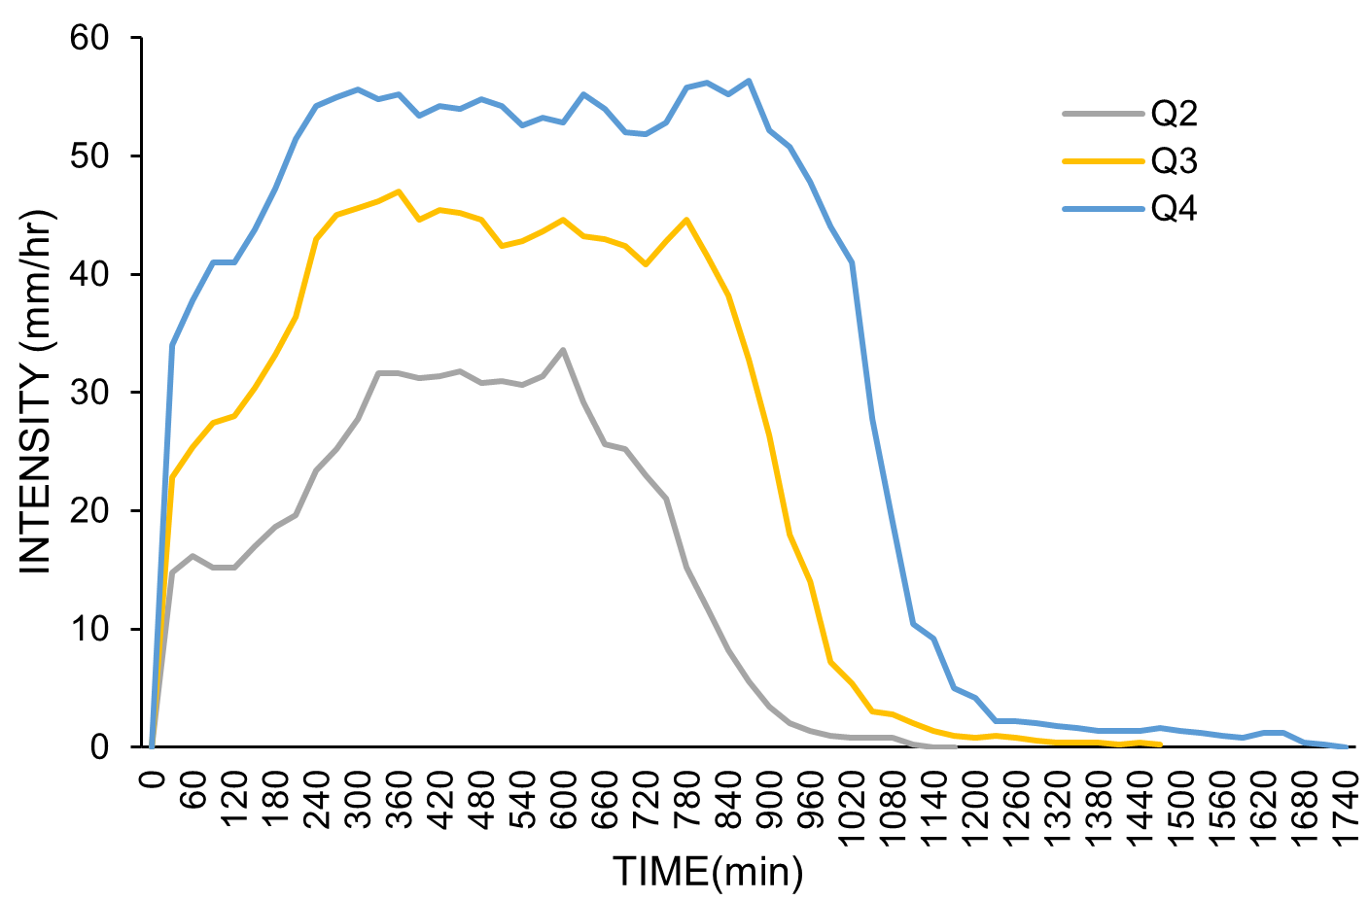
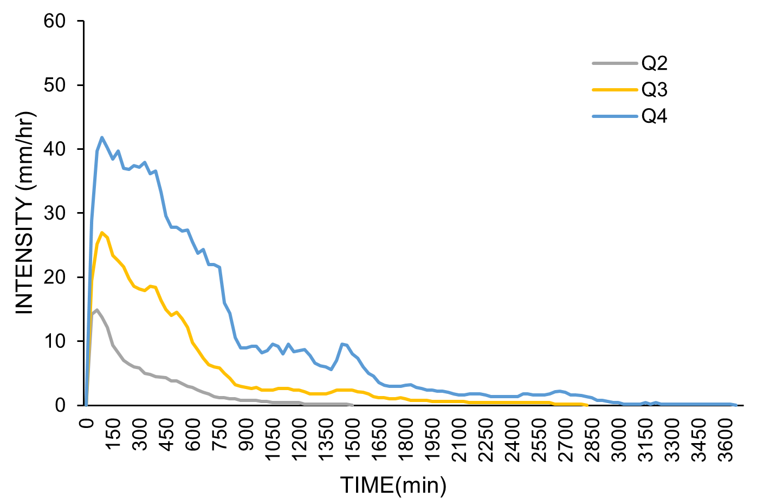
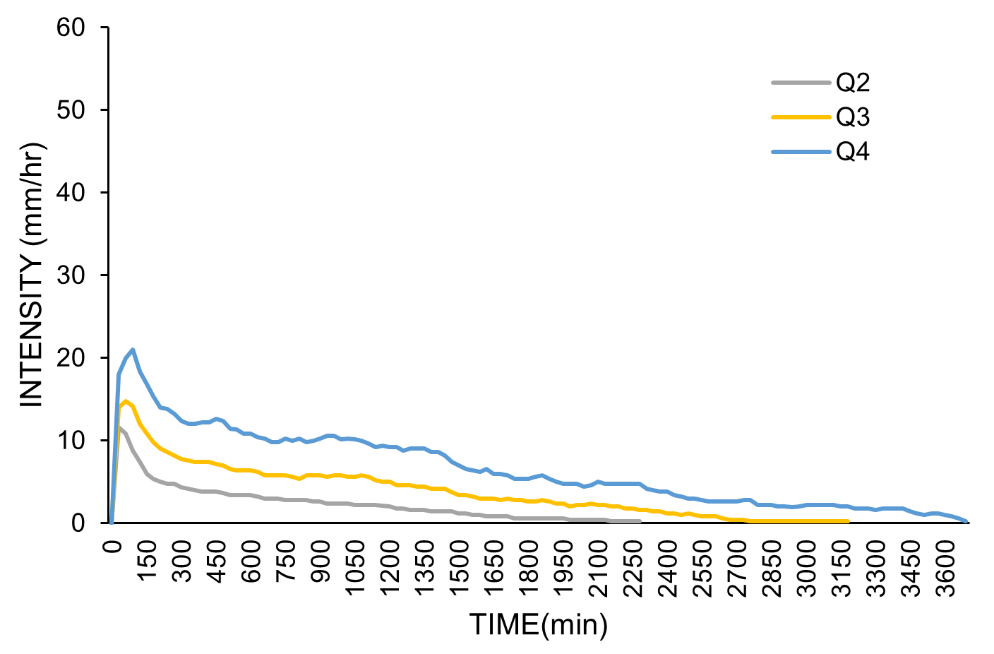
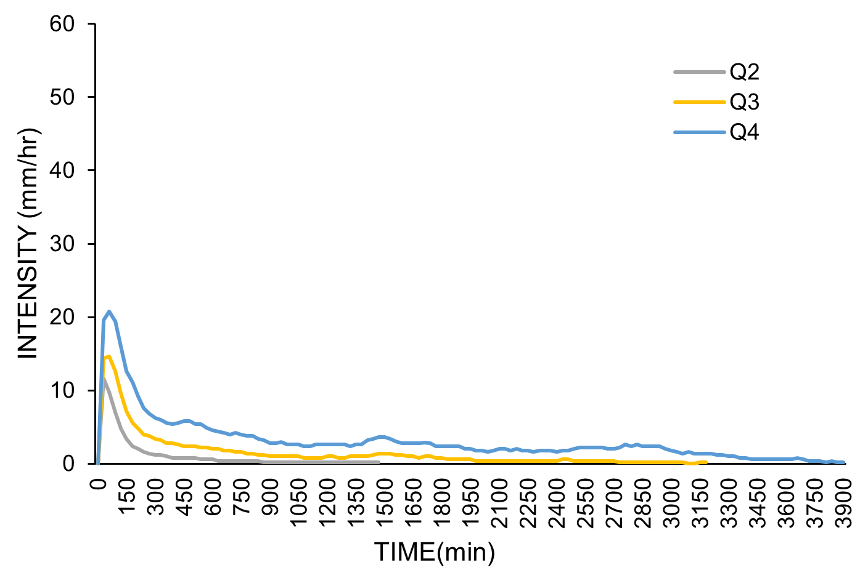
Representative Cluster Signals (RPSs)
Tropical Cyclone Enawo 2017
Tropical Storm Erika 2015
Q2 = 0.5
Q3 = 0.75
Q4 = 0.9
T1
T5
T1
T3
T2
T4
T4
T5

Slide 9
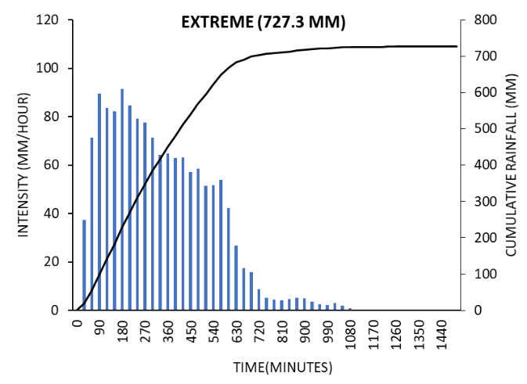
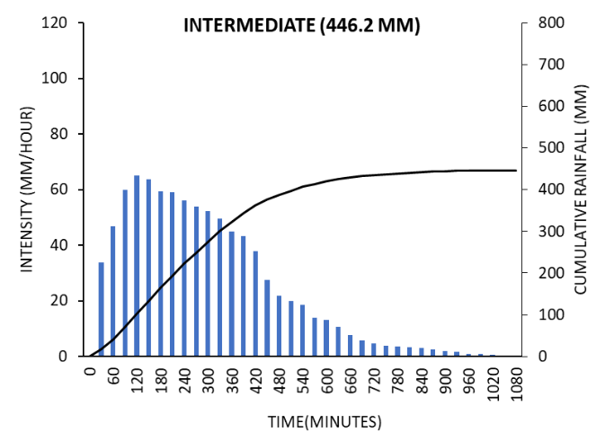
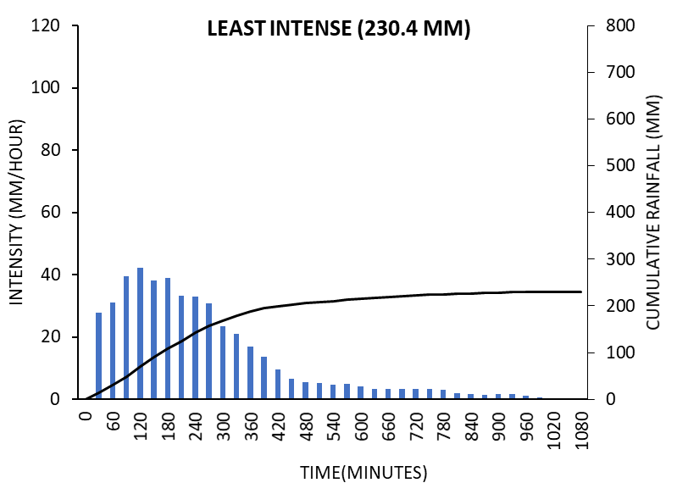
Final Rainfall Signals – Erika 2015
The storm is divided into three levels of magnitude
The rainfall dataset representative of tropical storm Erika’s spatial temporal variability

Slide 10
Conclusion/Recommendations
A new approach to generalize tropical cyclone associate rainfall for improved flood hazard mapping
With better understanding, the approach can be extended to more cyclones to build toward a tropical cyclone flood risk map
Potential of using satellite rainfall to make this generalization

Slide 11
Significance
An improved early warning system including localized variations of the threat
Better understanding of the system’s rainfall hence a more informed society about the localized impacts
Improvement of how we prepare for tropical cyclone related flooding

Slide 12

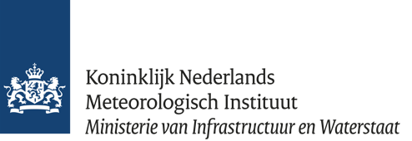
Acknowledgements
Catherine Nabukulu¹
Victor. G. Jetten¹
Janneke Ettema¹
Bastian van den Bout¹
Reindert. J. Haarsma²
University of Twente, Faculty of Geo-Information Science and Earth Observation (ITC)
Royal Netherlands Meteorological Institute (KNMI)
c.nabukulu@utwente.nl

Slide 13
Thank you
Questions?

